Slide 1
LESSON 1

Slide 2


pen
write

Slide 3
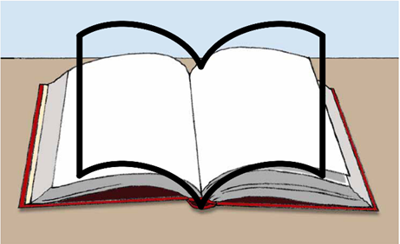

book
read
learn

Slide 4

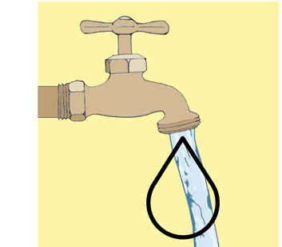
water

Slide 5
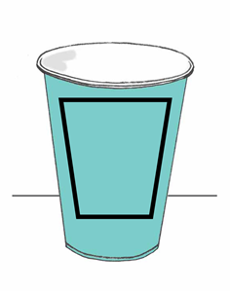

cup
drink

Slide 6
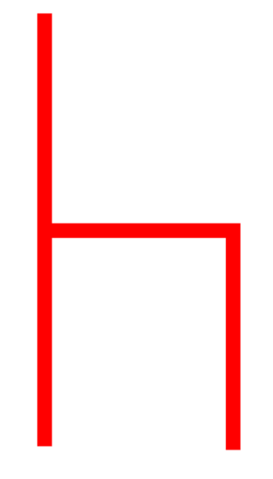
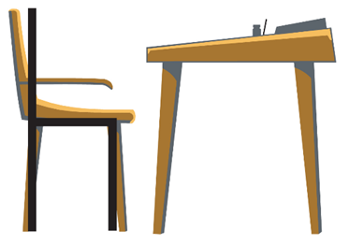
chair
sit

Slide 7

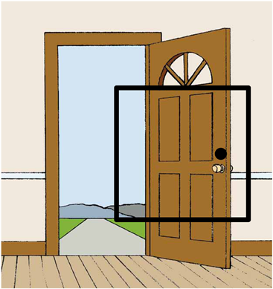
door

Slide 8
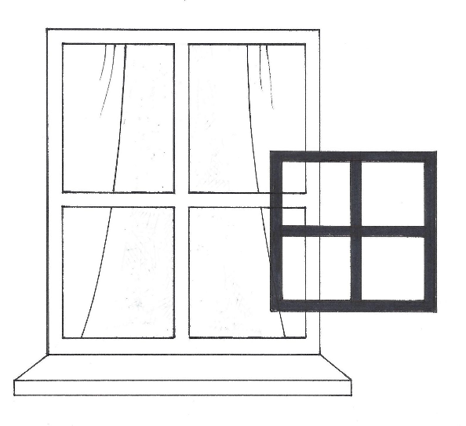

window

Slide 9
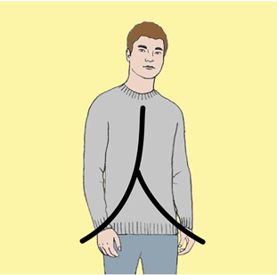
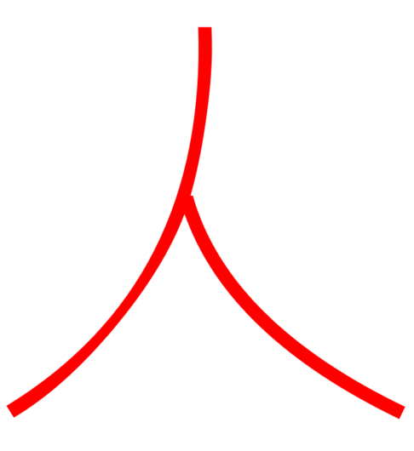
person

Slide 10
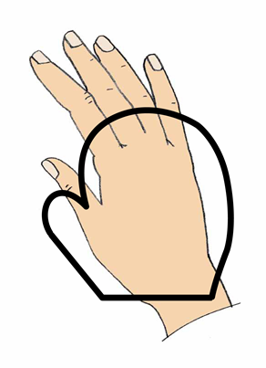

hand

Slide 11
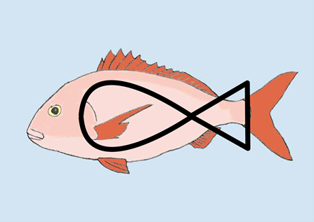

fish

Slide 12
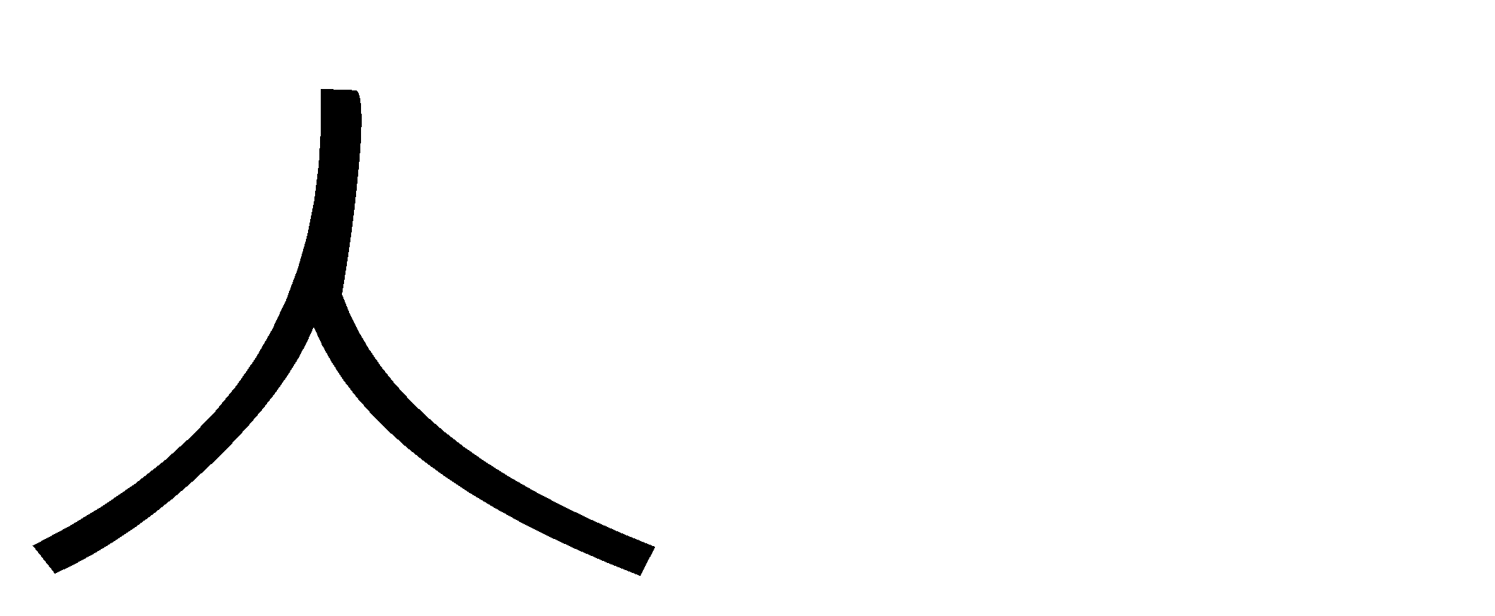
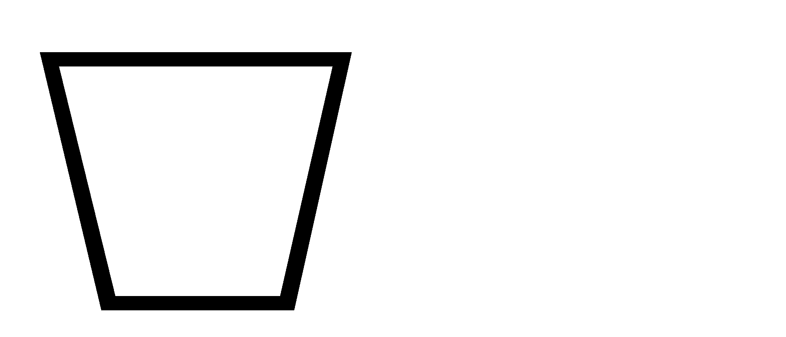
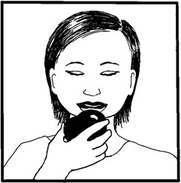
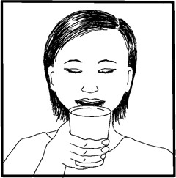
Notes:
A person drinks.

Slide 13
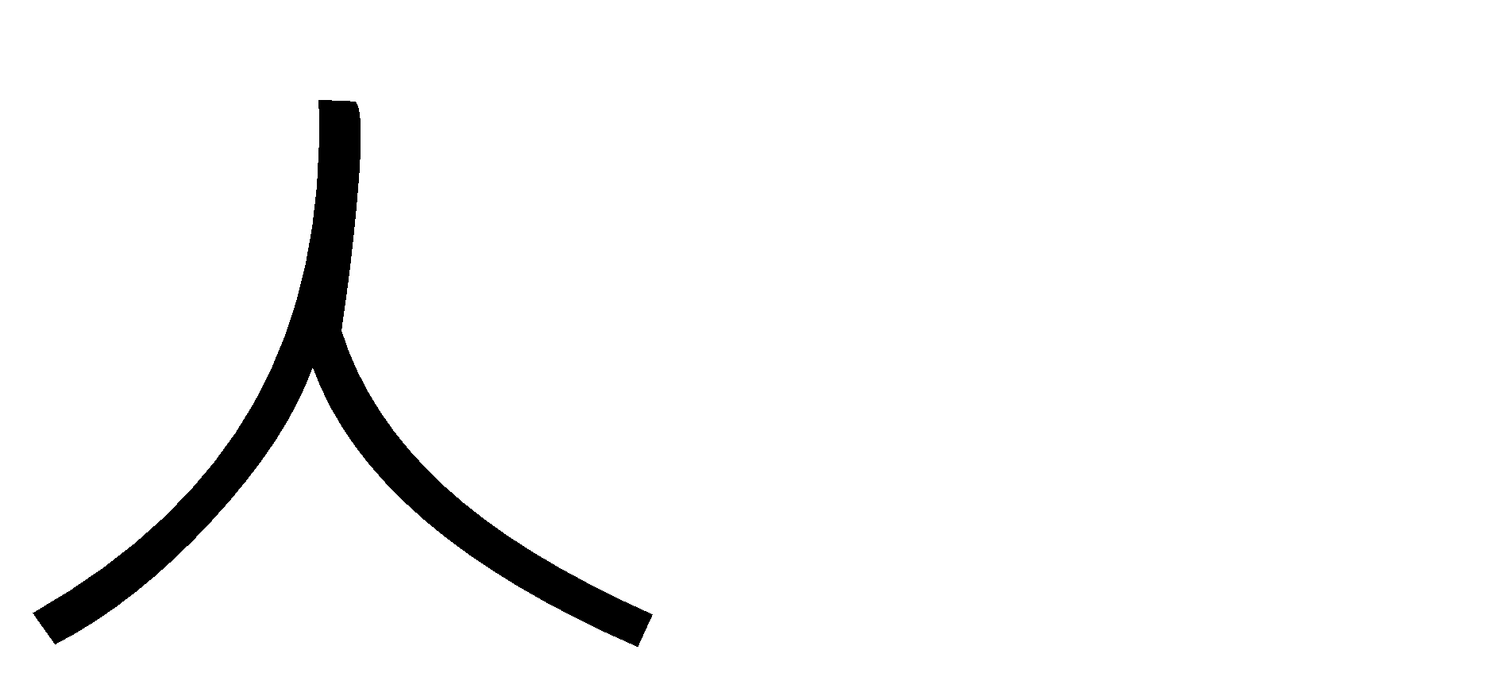

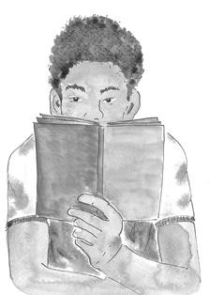
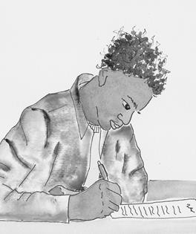
Notes:
A person writes.

Slide 14
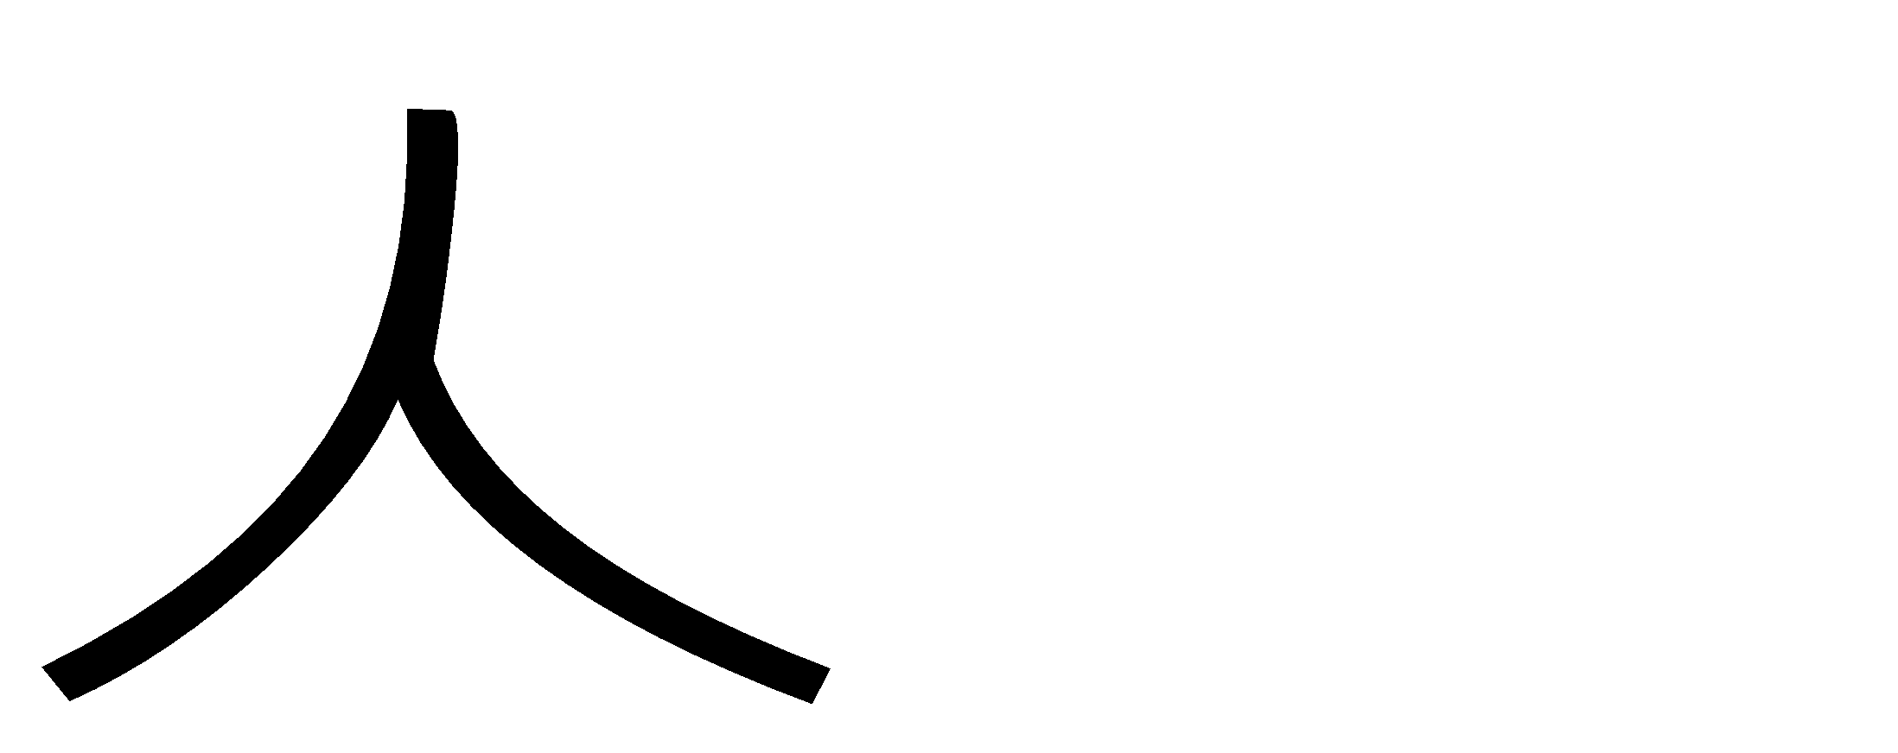

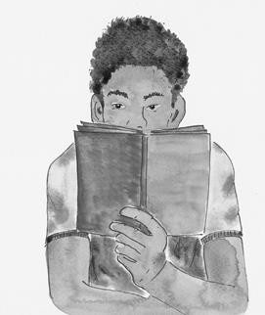

Notes:
A person reads.

Slide 15
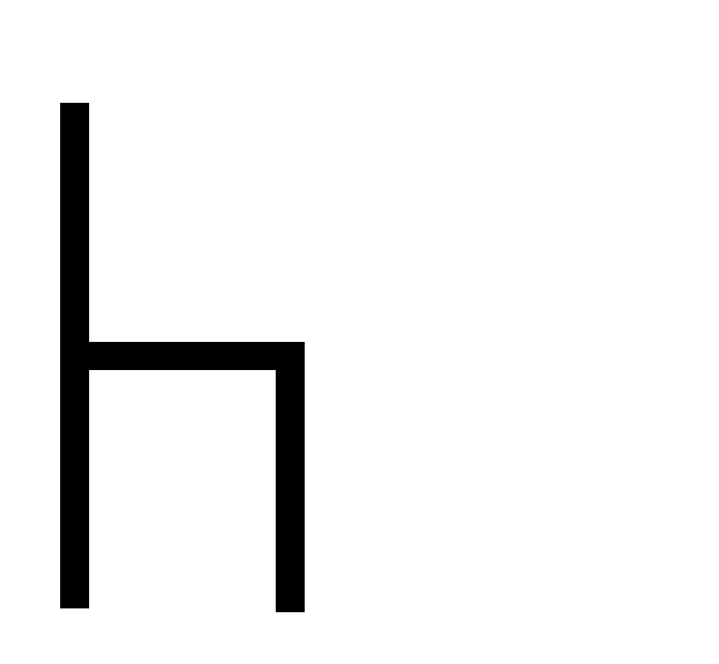
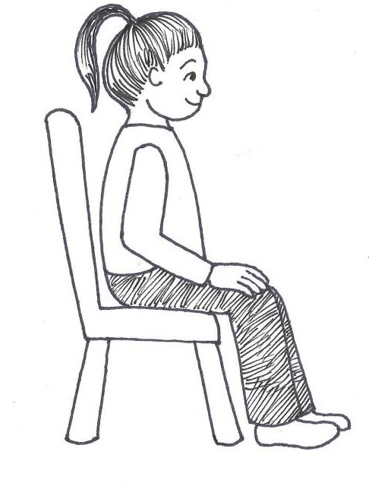
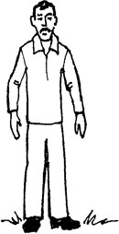
Notes:
A person sits.

Slide 16
LESSON 2

Slide 17
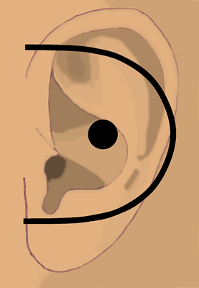

ear
hear

Slide 18
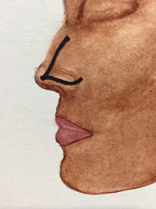
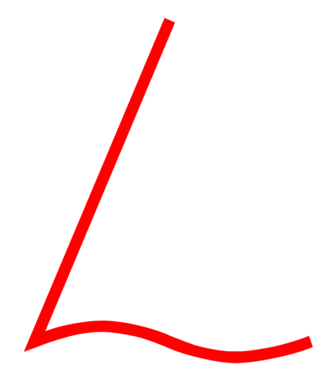
nose
smell

Slide 19
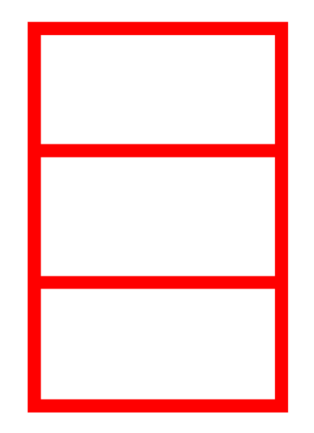
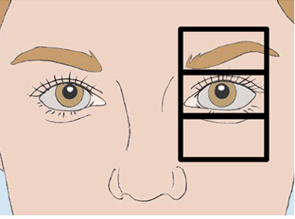
eye
see

Slide 20
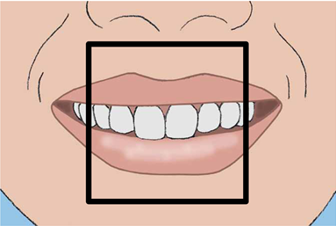

mouth
said
speak

Slide 21
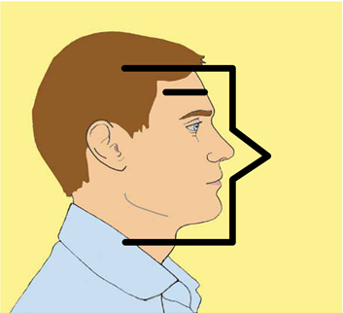
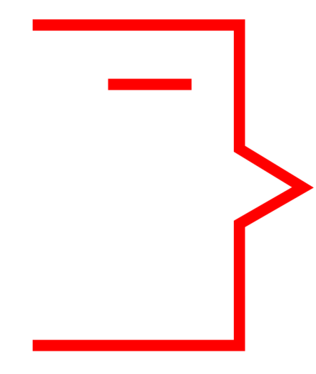
man

Slide 22


moon
night

Slide 23
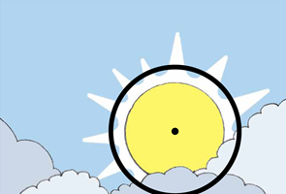

sun
day

Slide 24
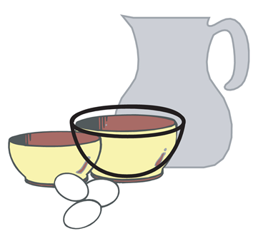
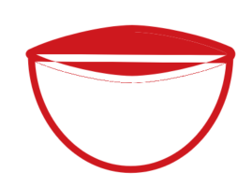
bowl
dish

Slide 25
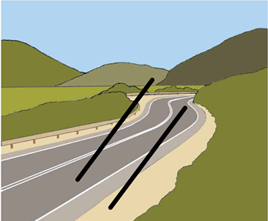

road
path
way

Slide 26
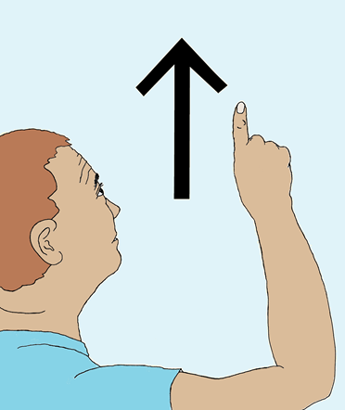
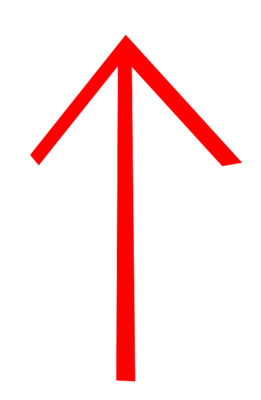
up

Slide 27
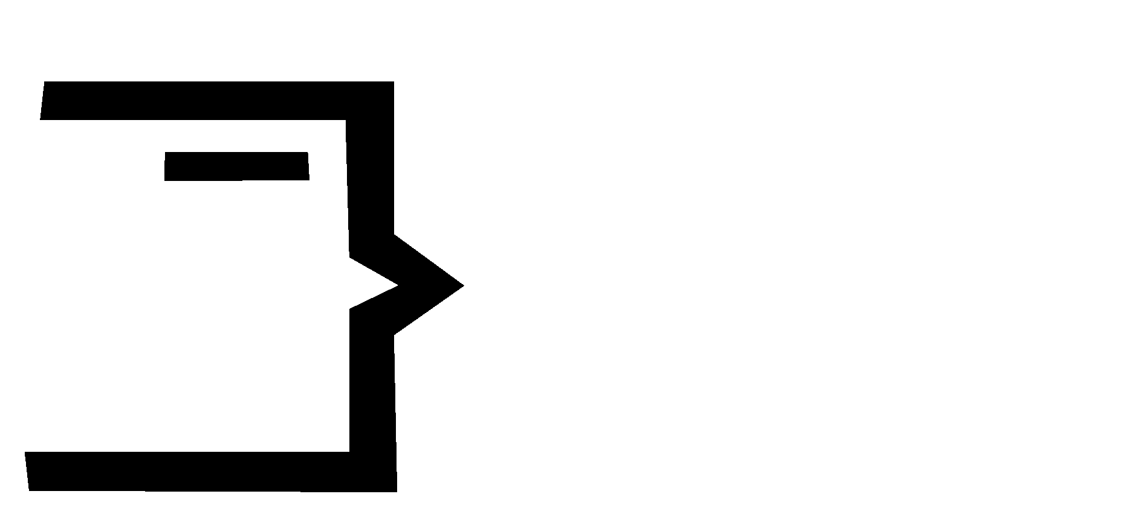
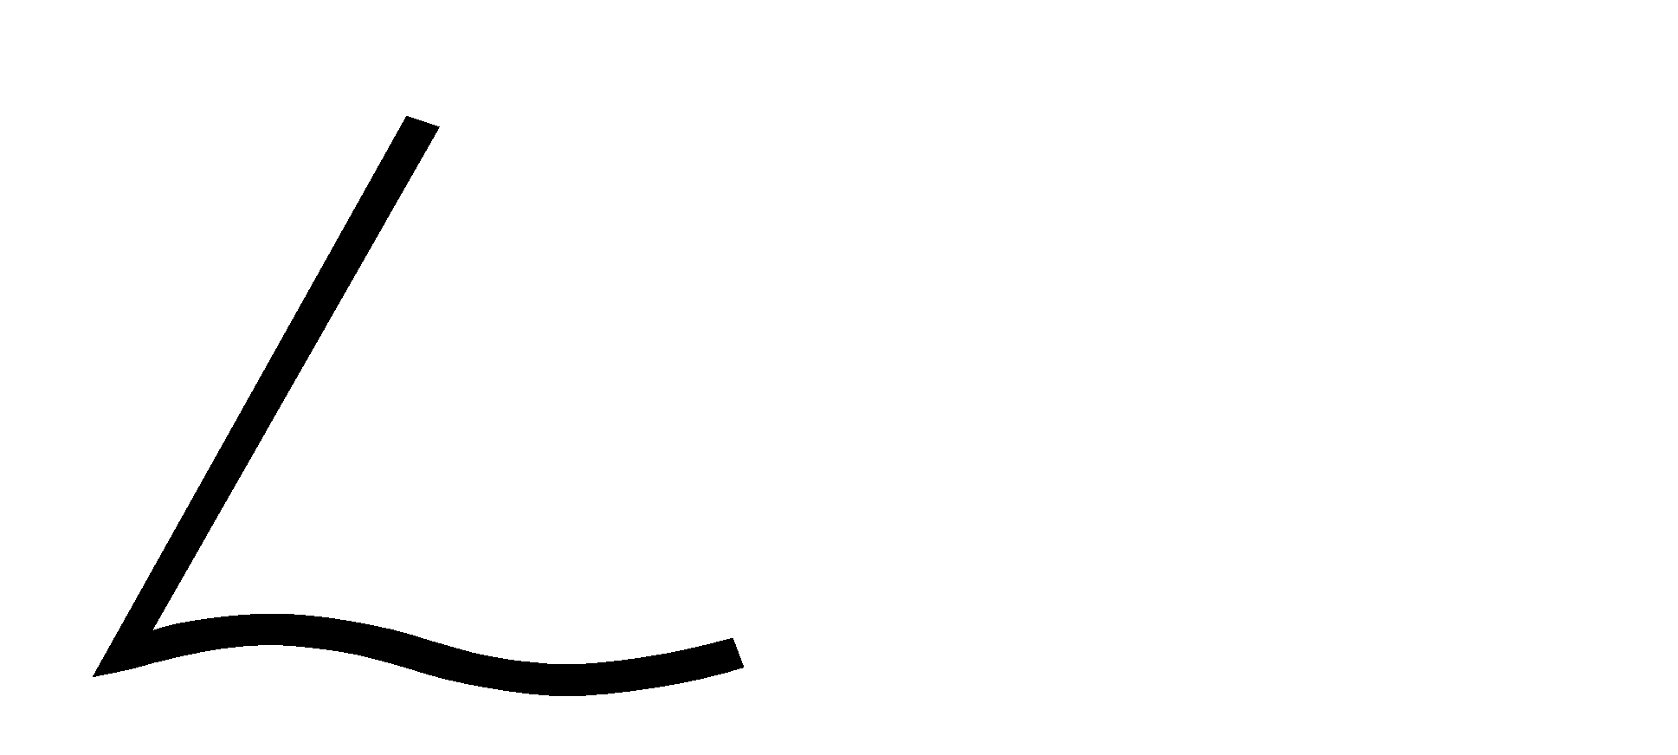

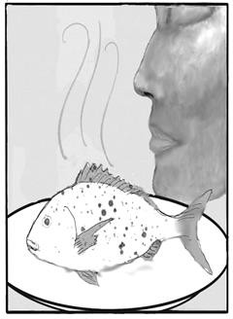
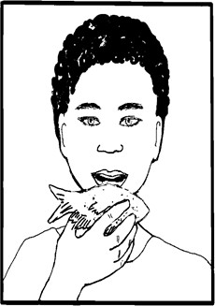
Notes:
A man smells a fish.

Slide 28
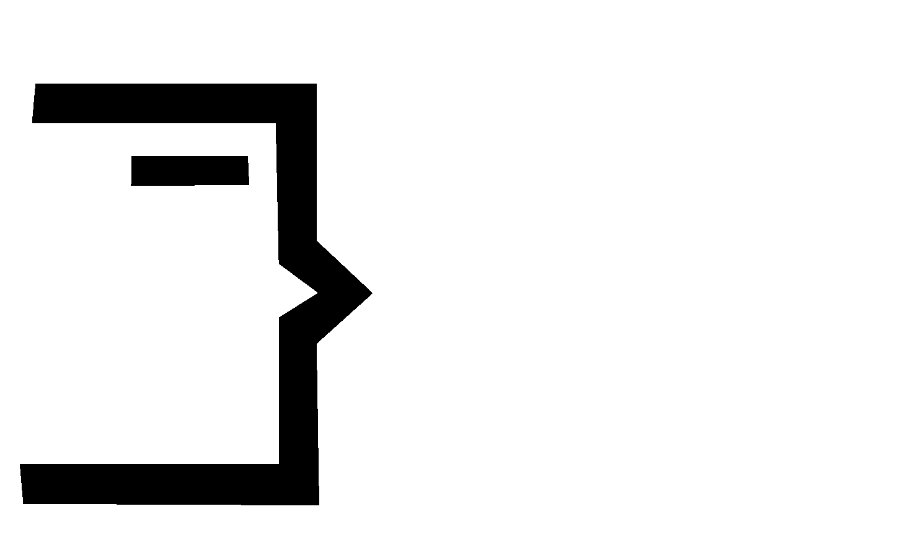


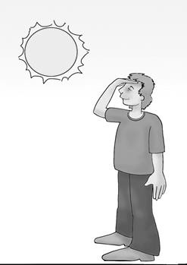
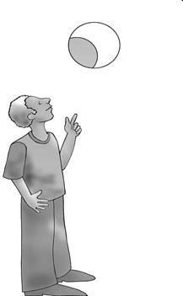
Notes:
A man sees the moon.

Slide 29

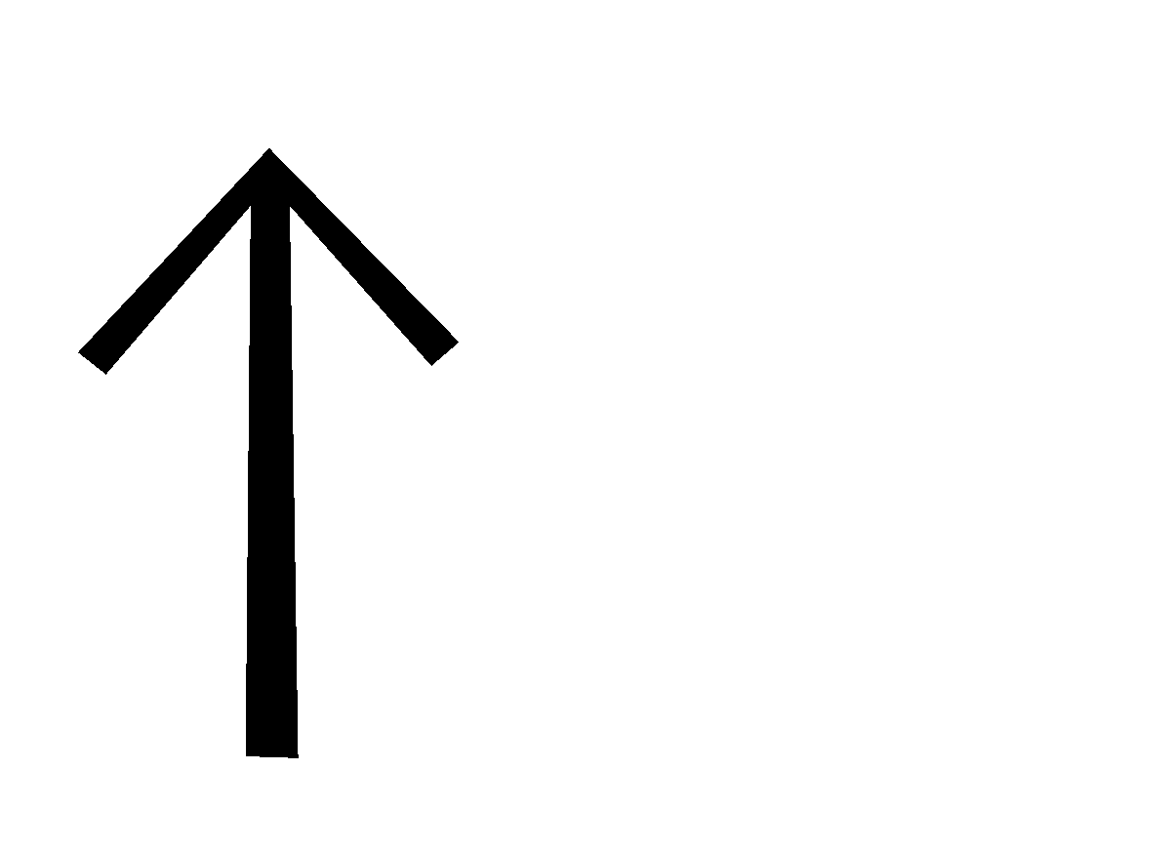
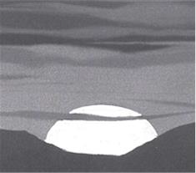
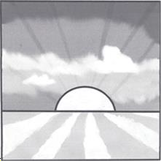
Notes:
The sun comes up.

Slide 30
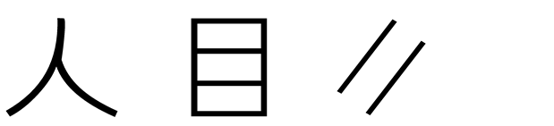
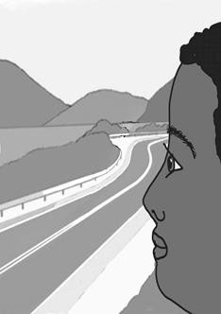
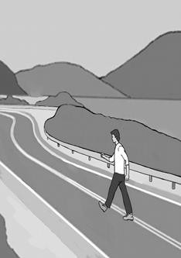
Notes:
A person sees the road.

Slide 31



Notes:
A man sees the sun come up.

Slide 32



Notes:
A man hears a person speaking.

Slide 33
LESSON 3

Slide 34


me

Slide 35


face

Slide 36


table

Slide 37


house

Slide 38


tree
plant

Slide 39


fruit

Slide 40


box

Slide 41


chain
bound
arrest

Slide 42


no not

Slide 43


king
lord
ruler
master

Slide 44



Notes:
The king speaks to me.

Slide 45



Notes:
I don’t see the house.

Slide 46



Notes:
A person is chained to a tree.

Slide 47



Notes:
The table has a box of fruit.

Slide 48



Notes:
I see a tree on the road.

Slide 49



Notes:
The house has no windows.

Slide 50
LESSON 4

Slide 51


river
stream

Slide 52


boat

Slide 53


storm

Slide 54


walk

Slide 55


knife
cut

Slide 56


sword

Slide 57


belt

Slide 58


stick

Slide 59


grain
wheat

Slide 60


stair
level

Slide 61



Notes:
I walk the road to the house.

Slide 62



Notes:
There is no boat in the storm.

Slide 63



Notes:
A person walks up the stairs.

Slide 64



Notes:
A man cuts the fruit on the table.

Slide 65



Notes:
The king has no belt.

Slide 66



Notes:
The man cuts the grain.

Slide 67
LESSON 5

Slide 68


animal

Slide 69


pig

Slide 70


snake

Slide 71


camel

Slide 72


horse

Slide 73


insect

Slide 74


hole

Slide 75


tie
knot

Slide 76


stretch

Slide 77


equal
same

Slide 78



Notes:
The man stretches the belt.

Slide 79



Notes:
A horse is tied to a tree.

Slide 80



Notes:
The pig does not walk.

Slide 81



Notes:
A horse is not the same as a camel.

Slide 82



Notes:
A person ties a belt.

Slide 83



Notes:
The house does not have any animals.

Slide 84
LESSON 6

Slide 85


fire
hot
heat

Slide 86


star

Slide 87


net

Slide 88


mountain

Slide 89


heart

Slide 90


work
do

Slide 91


fly

Slide 92


sweet

Slide 93


straight

Slide 94


soft

Slide 95



Notes:
I cut a hole in the box.

Slide 96



Notes:
The sun is hot.

Slide 97



Notes:
The insect flies straight.

Slide 98



Notes:
The fruit is sweet.

Slide 99



Notes:
The man sees a hole in the net.

Slide 100



Notes:
Fire goes up from the mountain.

Slide 101
LESSON 7

Slide 102


bone

Slide 103


wall

Slide 104


tower

Slide 105


land
ground
space
earth

Slide 106


shield

Slide 107


whip

Slide 108


measure

Slide 109


left

Slide 110


time

Slide 111


cross

Slide 112



Notes:
The fish has no bones.

Slide 113



Notes:
The animal works the grain field.

Slide 114



Notes:
The tower is to the left of the wall.

Slide 115



Notes:
I whip the horse.

Slide 116



Notes:
A man measures the stick.

Slide 117



Notes:
I do not have time to write.

Slide 118
LESSON 8

Slide 119


part
some

Slide 120


all
whole

Slide 121


color

Slide 122


good

Slide 123


start
beginning

Slide 124


from

Slide 125


air

Slide 126


love
compassion

Slide 127


know
knowledge

Slide 128


new

Slide 129



Notes:
The king loves his horses.

Slide 130



Notes:
The man has a good heart.

Slide 131



Notes:
I see all colors.

Slide 132



Notes:
No air is coming from the mouth.

Slide 133



Notes:
I write a new book.

Slide 134



Notes:
I don’t know the person.

Slide 135
LESSON 9

Slide 136


zero

Slide 137


one

Slide 138


two

Slide 139


three

Slide 140


four

Slide 141


five

Slide 142


six

Slide 143


seven

Slide 144


eight

Slide 145


nine

Slide 146


ten

Slide 147
LESSON 10

Slide 148


thing

Slide 149


clothing
fabric

Slide 150


number

Slide 151


thousand

Slide 152


many

Slide 153


near

Slide 154


small

Slide 155


very
Showing Emphasis

Slide 156


people
person

Slide 157


woman

Slide 158
LESSON 11

Slide 159


crowd
multitude
person
.

Slide 160


closed
door

Slide 161


open
no, closed

Slide 162


in
inside
door, thing

Slide 163


on
On_top_of
thing

Slide 164


away
thing

Slide 165


ear
no, ear

Slide 166


mute
mouth, no

Slide 167


put
hand, thing

Slide 168


touch
thing, hand

Slide 169
LESSON 12

Slide 170


bring
take
carry
hand, thing

Slide 171

tongue
mouth, clothing

Slide 172


spit
mouth, forward, water

Slide 173


sigh
mouth, air

Slide 174


free
chain, no

Slide 175


desire
want
will
love, heart

Slide 176


beg
very, mouth, desire

Slide 177


Jesus
king, cross
.

Slide 178


father
man, love

Slide 179


God
king, father

Slide 180


heaven
house, God

Slide 181
LESSON 13

Slide 182


period
This symbol marks the end of a complete thought.

Slide 183


comma
This symbol indicates a break within a complete thought.

Slide 184


exclamation point
This symbol marks the end of a sentence spoken with emphasis or strong emotion.

Slide 185


question mark
This symbol indicates a question is being asked.

Slide 186


quotation marks
These symbols appear at the beginning and end of something that someone says.

Slide 187

single quote marks
These symbols are used to indicate a quotation inside another quotation.

Slide 188



possessive
This symbol is used to show possessive.

Slide 189




Proper Noun indicator
This symbol indicates a Proper Noun – a name of a man, woman, village, land, sea

Slide 190


Notes:
They brought to Jesus someone who was deaf and had difficulty speaking.

Slide 191


Notes:
They begged Jesus to lay his hand on him.

Slide 192


Notes:
Jesus took him aside from the crowd privately.

Slide 193


Notes:
Jesus put His fingers into his ears.

Slide 194


Notes:
After spitting

Slide 195


Notes:
Jesus touched his tongue.

Slide 196


Notes:
Jesus looked up to Heaven.

Slide 197


Notes:
Jesus sighed.

Slide 198


Notes:
Jesus said to him “ Ephphatha, “ that is to say, “Open!”

Slide 199


Notes:
Immediately his hearing was opened.

Slide 200


Notes:
His tongue was loosened. What prevented his tongue was destroyed.

Slide 201


Notes:
He could speak clearly.

Slide 202
SALVATION LESSON

Slide 203


bad
no, good

Slide 204


sin sinful
bad, work

Slide 205


money
king

Slide 206


buy
forward, money

Slide 207


death
die dead
no, heart

Slide 208


gift
hand, love

Slide 209


give
gift, forward

Slide 210


only alone
very, one

Slide 211


son
small, father

Slide 212


believe
faith
know, cross

Slide 213


alive
life
live
good, heart

Slide 214


always eternity eternal
all, time

Slide 215



Slide 216



Slide 217



Slide 218



Slide 219



Slide 220



Slide 221



